Slide 1
SER310 Website Review The “Westerpiece”
Reviewer: Tyler
Reviewee: Wes

Slide 2
Demo

Slide 3
Results
 | Summary of results
 |  | Raw score | # Questions | # Answers | Score
 | Home Page | 13 | 20 | 18 | 86%
 | Task Orientation | 17 | 44 | 26 | 83%
 | Navigation & IA | 13 | 29 | 20 | 83%
 | Forms & Data Entry | 0 | 23 | 0
 | Trust & Credibility | 5 | 13 | 11 | 73%
 | Writing & Content Quality | 16 | 23 | 20 | 90%
 | Page Layout & Visual Design | 20 | 38 | 33 | 80%
 | Search | 0 | 20 | 0
 | Help, Feedback & Error Tolerance | 0 | 37 | 13 | 50%
 | Overall score |  | 247 | 141 | 78%

Slide 4
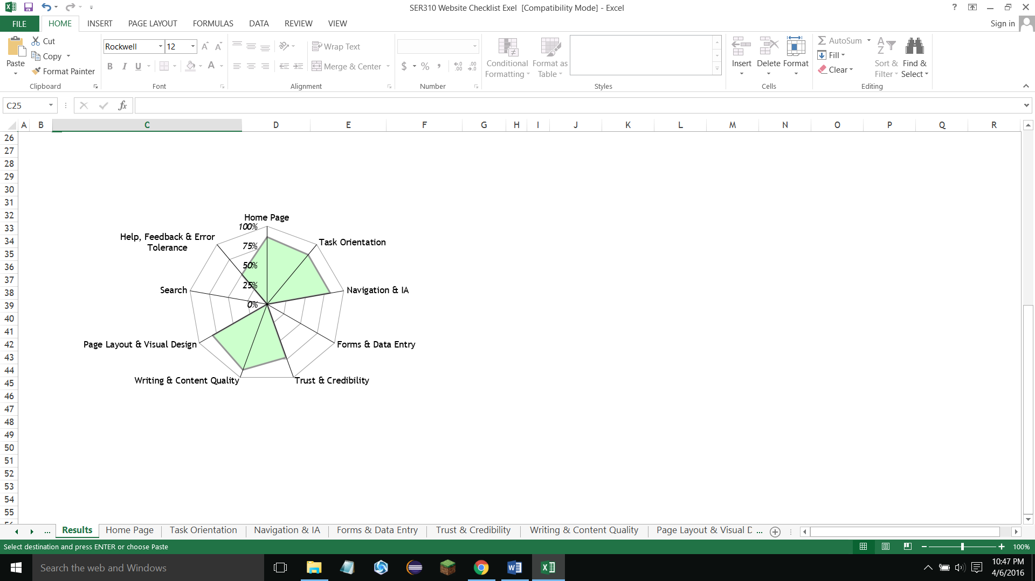
Results

Slide 5
Low-Scoring Categories
Under 80% on evaluation:
Trust and Credibility
Page Layout and Visual Design
Help, Feedback, and Error Tolerance

Slide 6
Trust and Credibility
No third-party support
No address or location (Street address, not just “In CCE Building”)
No contact support for help

Slide 7
Page Layout and Visual Design
Can miss info below initial screen (forget to scroll)
Links remain blue after being clicked
No color use to distinguish blocks of info
No horizontal and vertical organization (only top-down)
No clickable logo

Slide 8
Help, Feedback, and Error Tolerance
Word of note: these sites aren’t meant to handle errors because of the simplicity
Incomplete FAQ (show page)
No 404 page
No feedback
Got lowest score of 50, mainly because 80% of checks were “not applicable” because this isn’t a shopping site.

Slide 9
Proposed Changes
Finish FAQ page
Make logo clickable and go to home
Add school address somewhere
Add some kind of live support
Turn links purple after clicking
Use color to help organize pages
Add 404 page and site feedback

